Slide 1

A
Comment
on
//Comments
(ok maybe more of a rant)

Slide 2
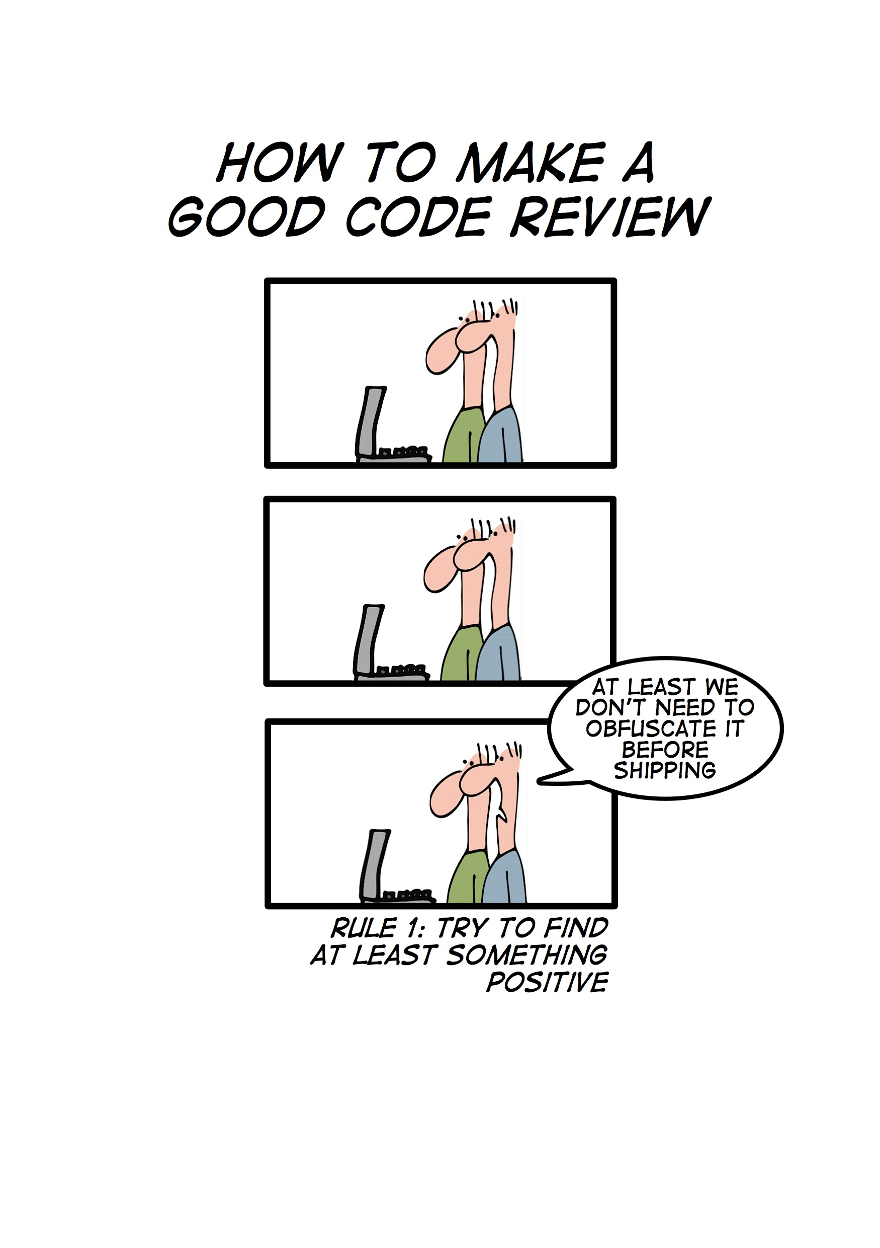

Slide 3

The proper use of comments is to compensate our failure to express ourselves in code
UNCLE BOB

Slide 4
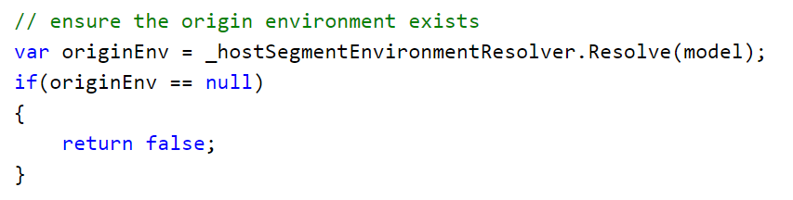
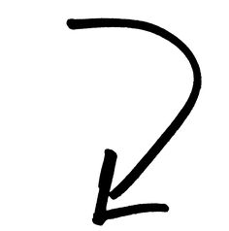
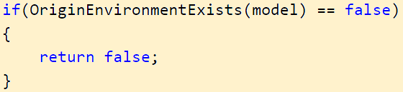

It looks like you are trying to write some comments.
Did you mean..?

Slide 5

If the source code needs comments, it either means that it does not respect coding standards or it is too complex
SONARQUBE

Slide 6
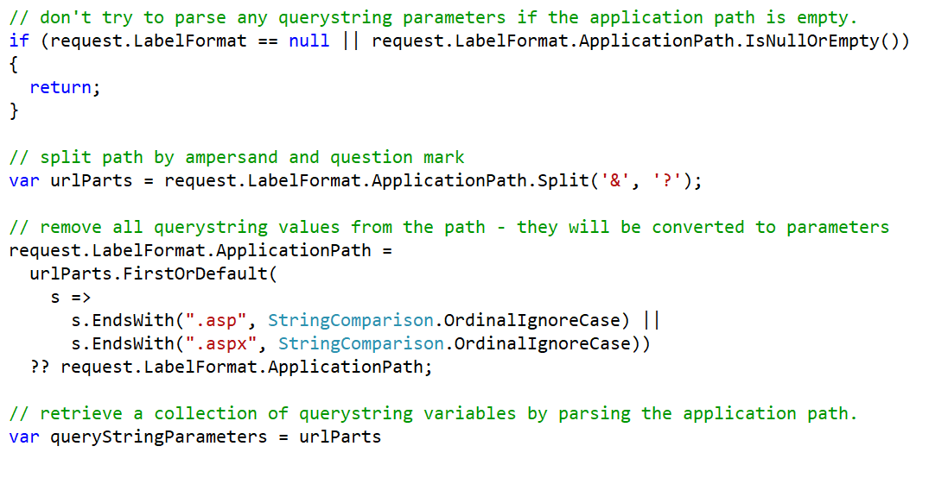

Slide 7

Inaccurate comments are far worse than no comments at all
UNCLE BOB

Slide 8
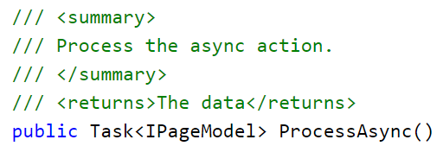



Slide 9
WHAT
WHY

Slide 10
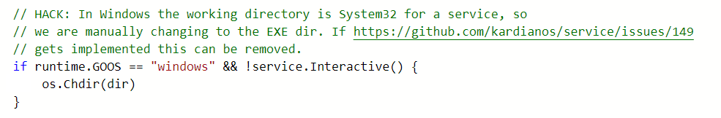
EXPLAIN WHY

Slide 11
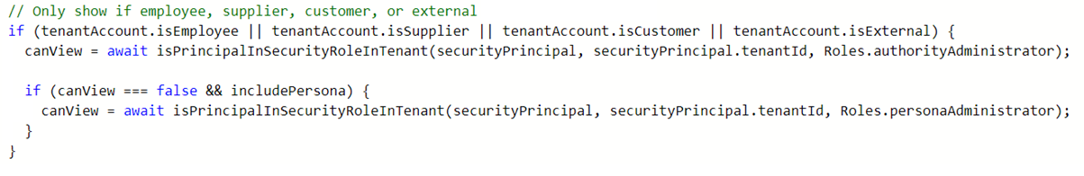
NOT WHAT

Slide 12
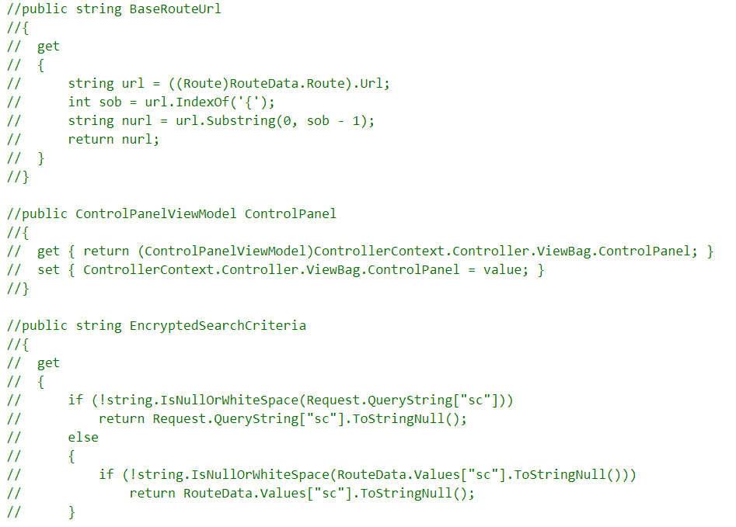
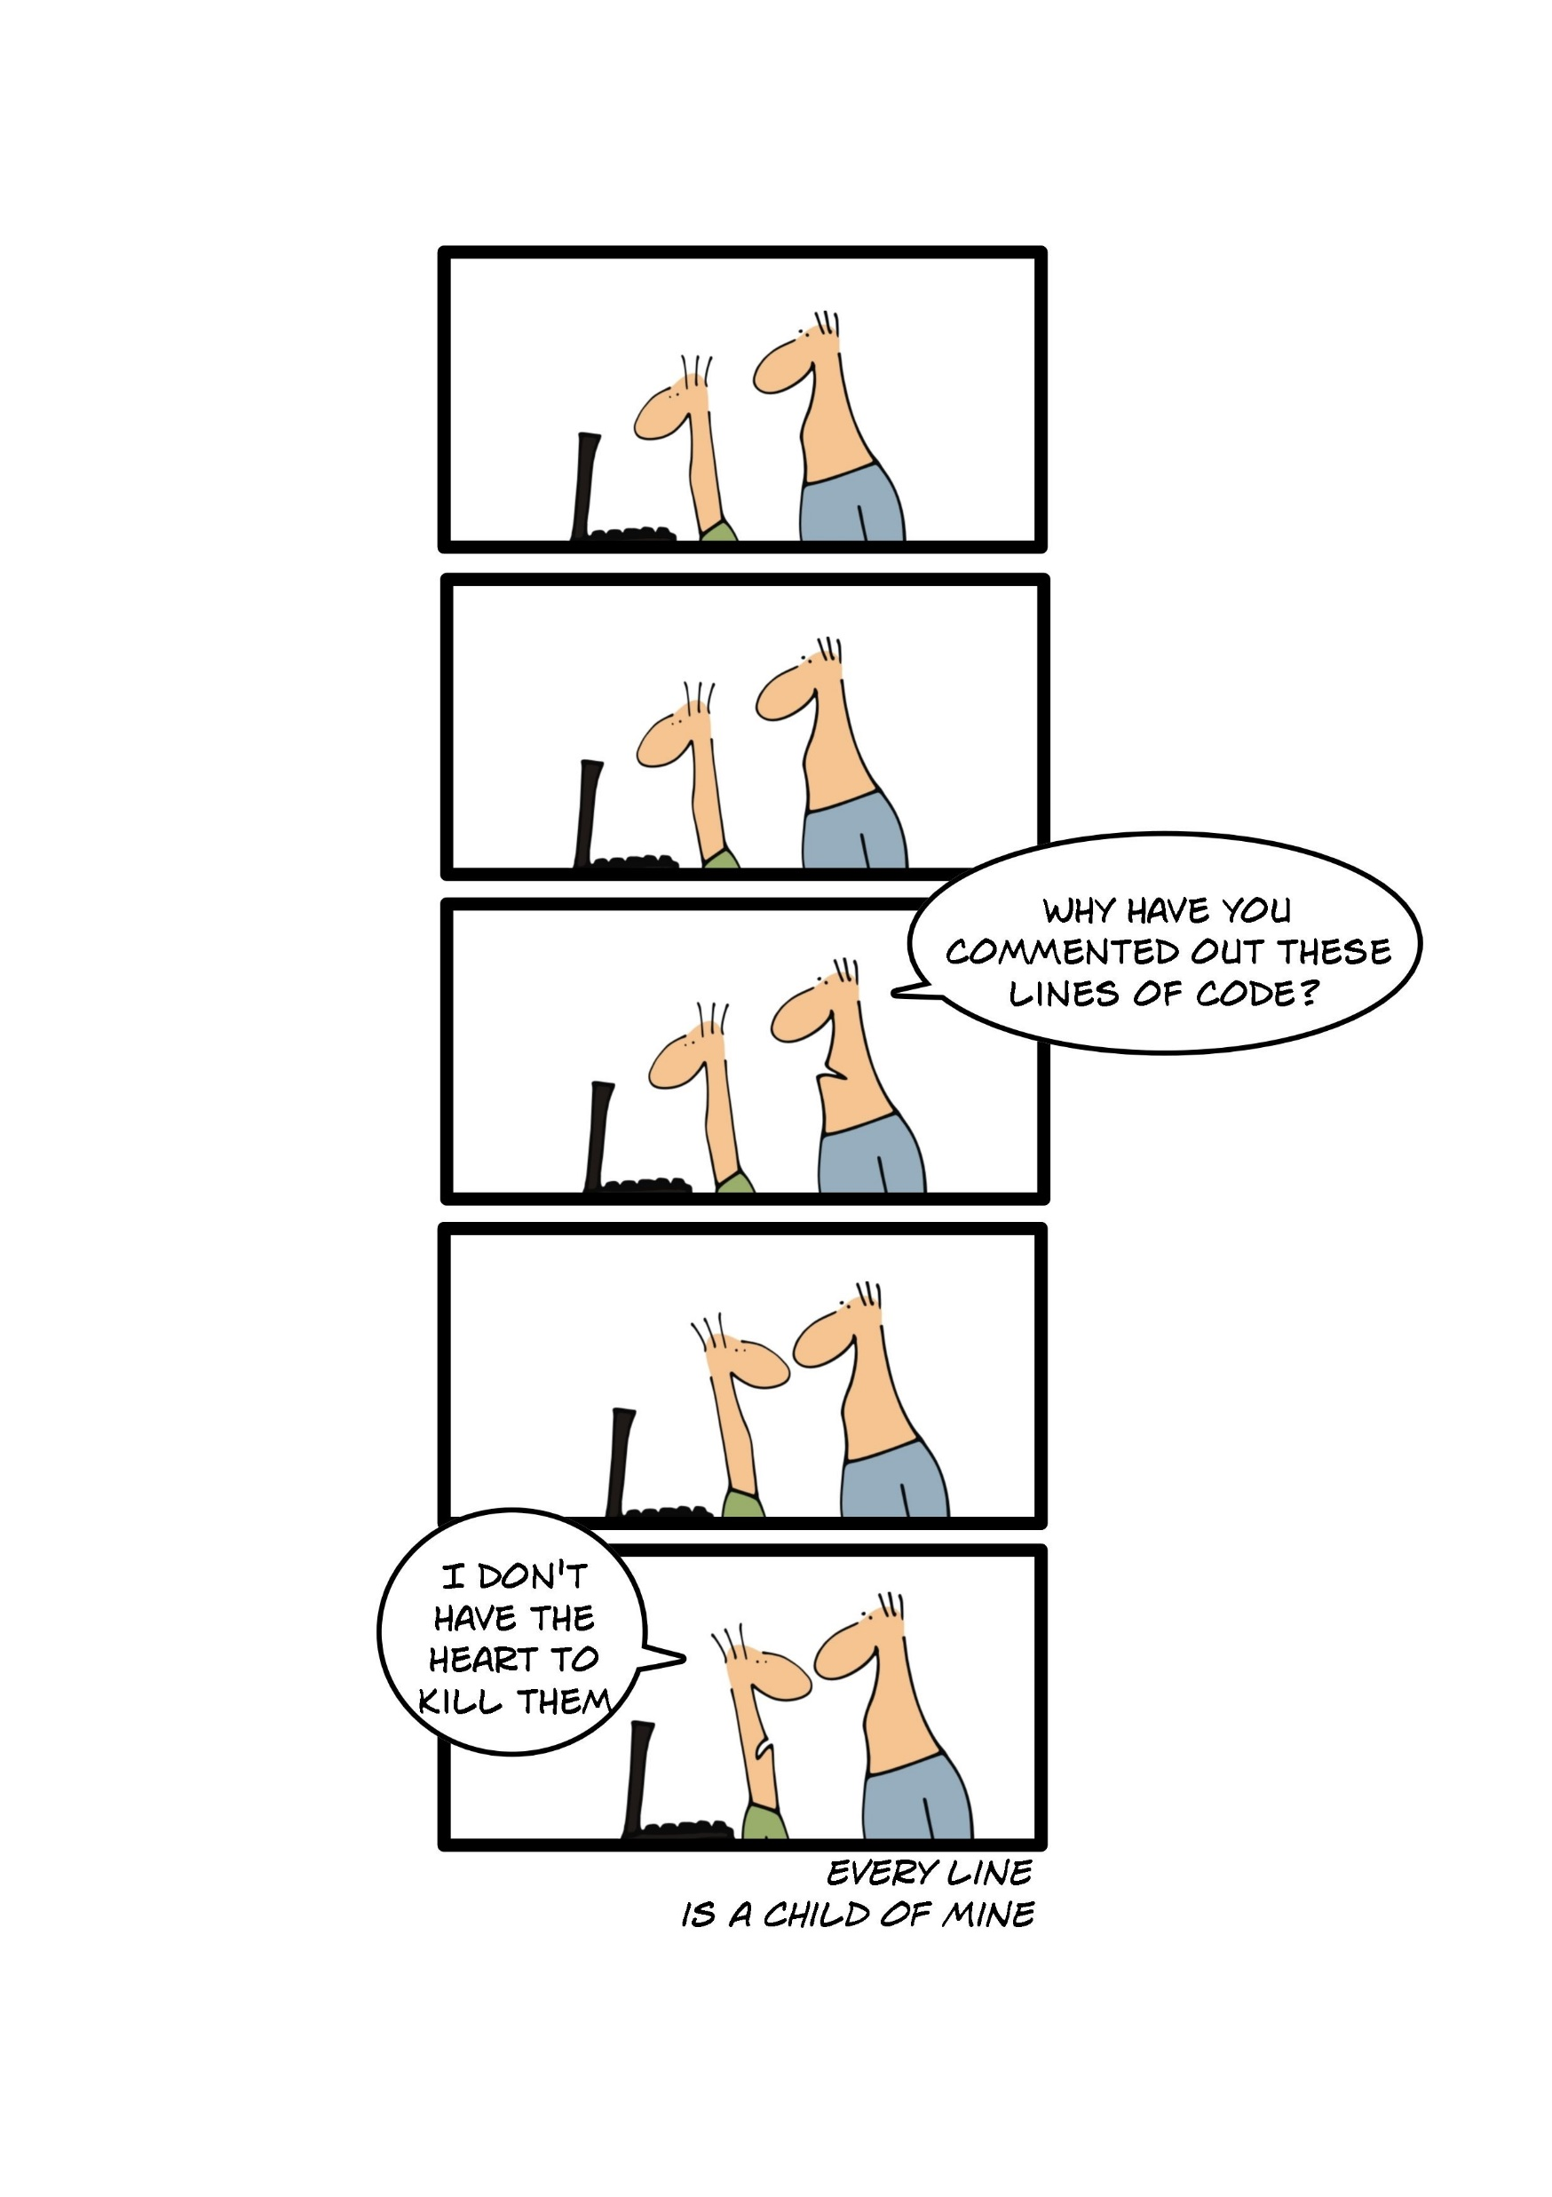

Slide 13
OK..
THEY’RE NOT
ALL BAD

Slide 14
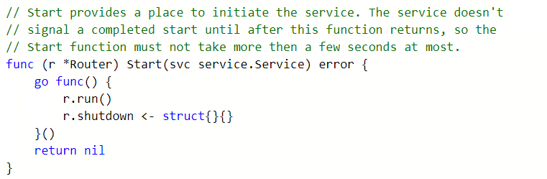


Slide 15
IS THERE
DEMONSTRATABLE
VALUE?

Slide 16
YOUR
COMMENT
COULD BE A
CODE SMELL

Slide 17
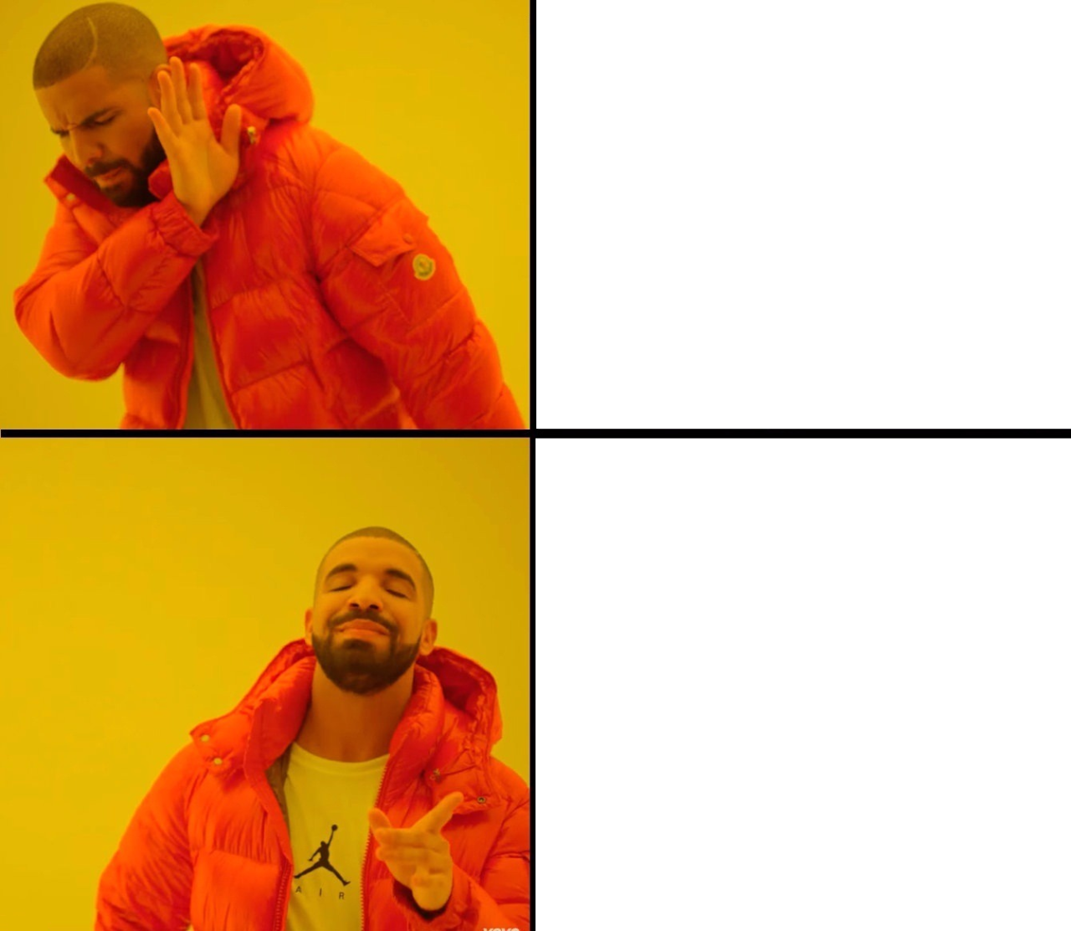

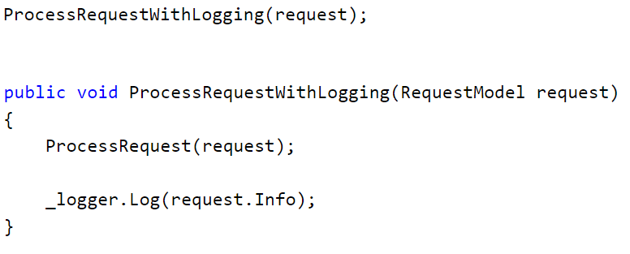
BEFORE
AFTER
. . .
New Call
Original Method

Slide 18
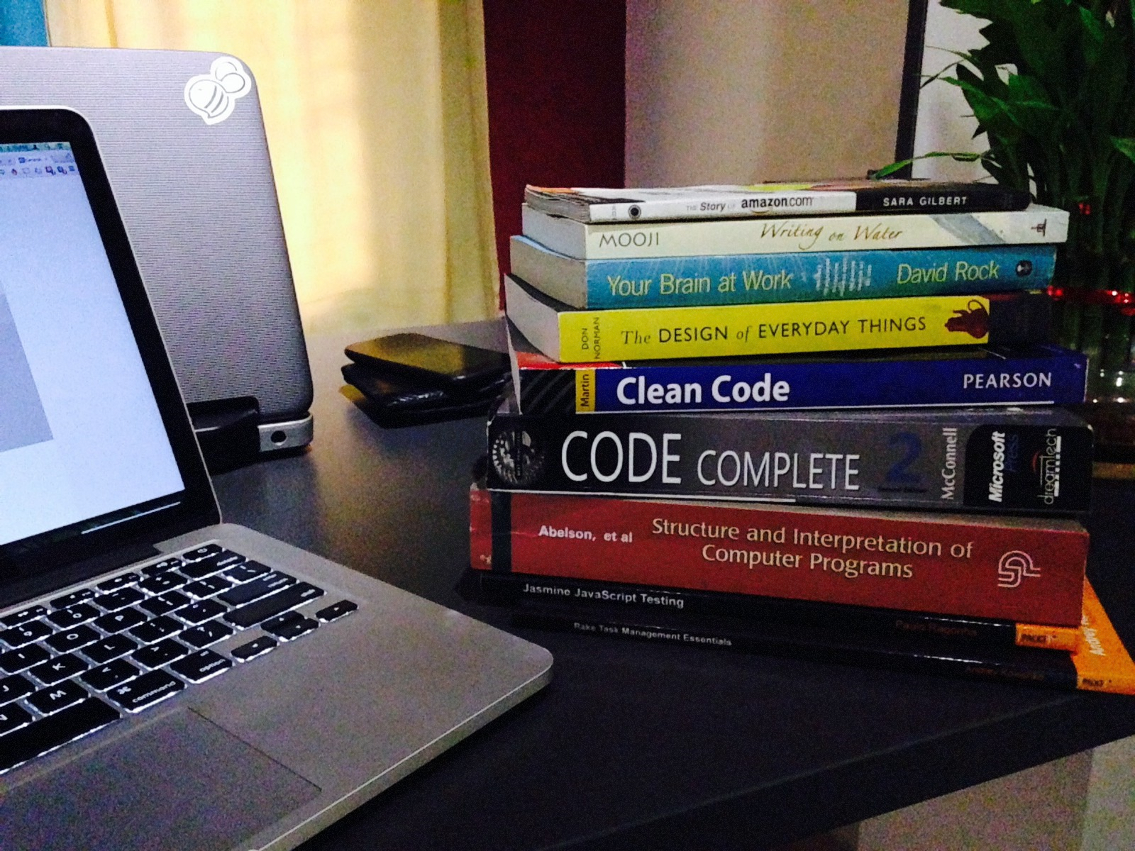
CLEAN CODE
ROBERT C. MARTIN

Slide 19
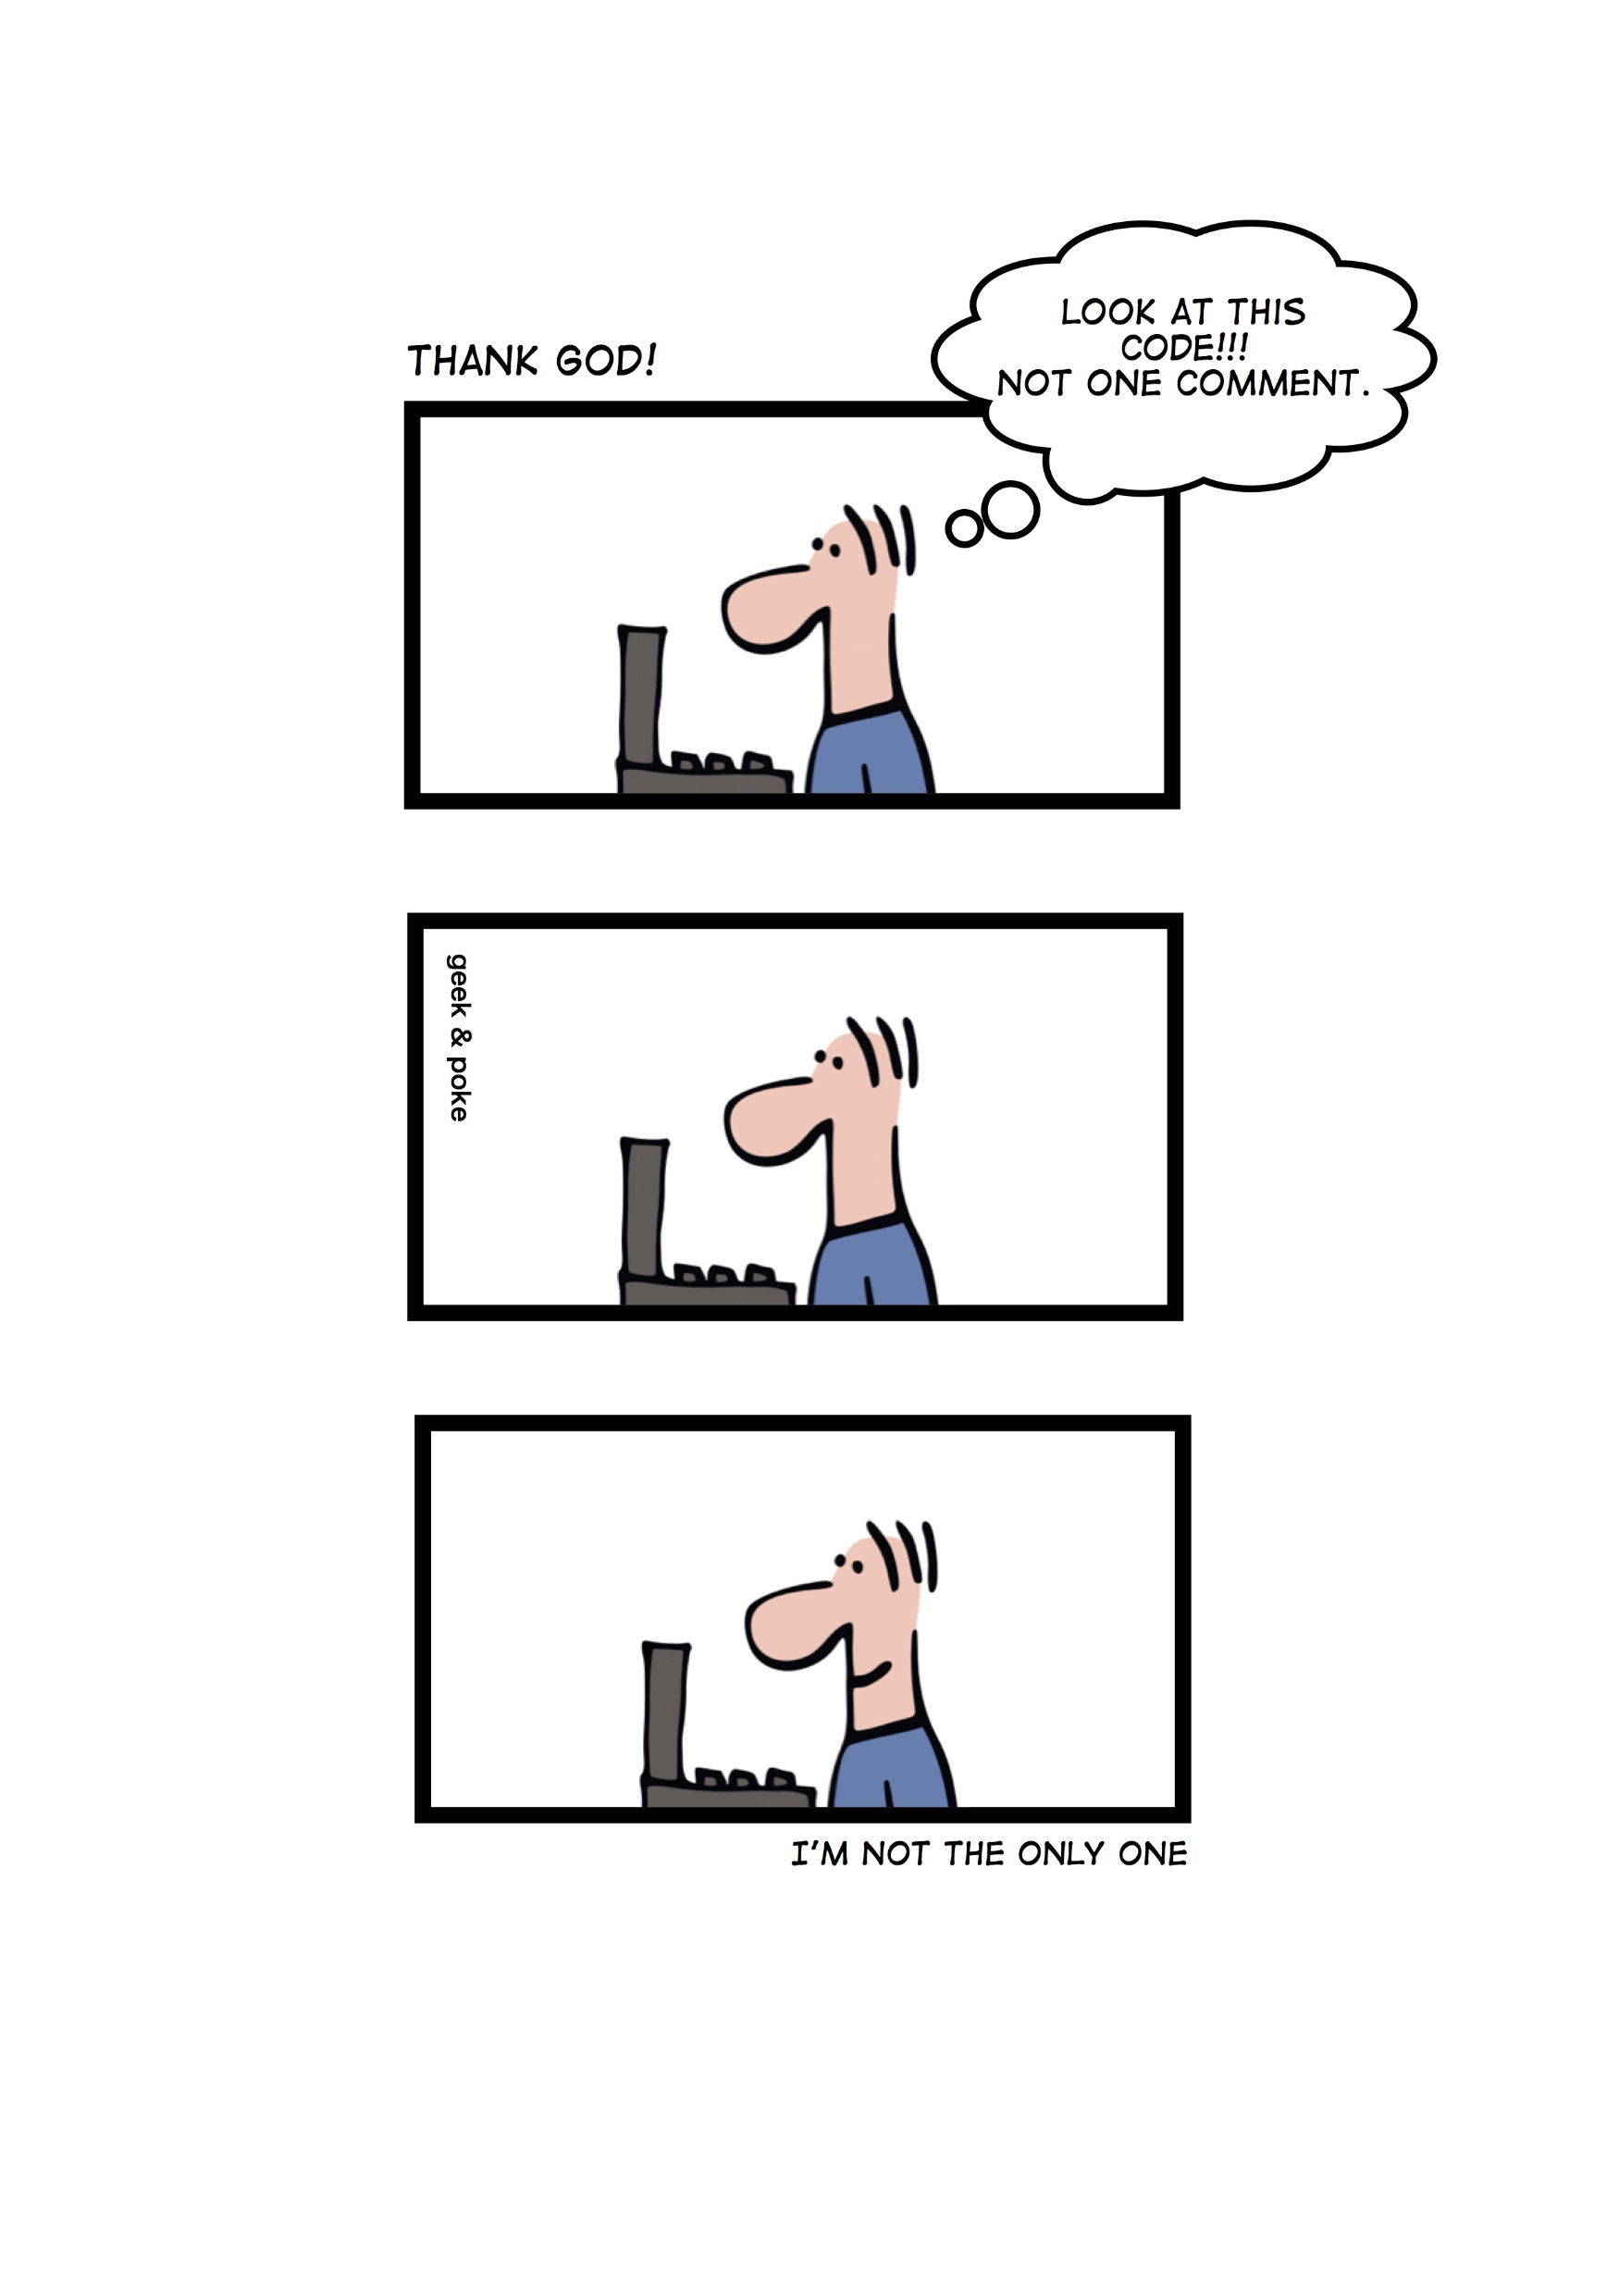

Slide 20

JUST (DON’T) DO IT

